Slide 1
A Systems Approach to Planning Evaluations
The SEP and the Netway
William M. Trochim
Cornell University
Presentation to the Centers for Disease Control and Prevention
May 27, 2014

Slide 2
Overview
The importance of program models
Developing high-quality program models
  Need a “protocol” – step-by-step
  Need (web-based) tools
The Systems Evaluation Protocol
The Netway Cyberinfrastructure
Examples: CDC’s Logic Models for FOAs
How good models lead to good evaluation

Slide 3

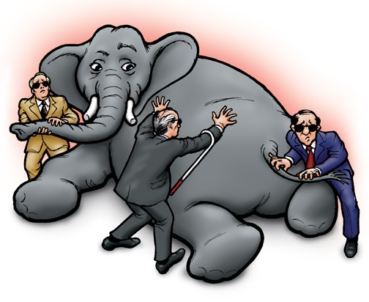
The Importance of Program Models
A program model provides a “high-level view
Helps multiple stakeholders see multiple perspectives
Notes:
Stakeholders matter for evaluation planning
Because you really need diverse perspectives to get a full understanding of what the program is and what it does or can do
Because their priorities should be taken into consideration – often have to be taken into consideration, if it’s a key funder – in deciding what the evaluation focus should be and how to conduct the evaluation.

Slide 4
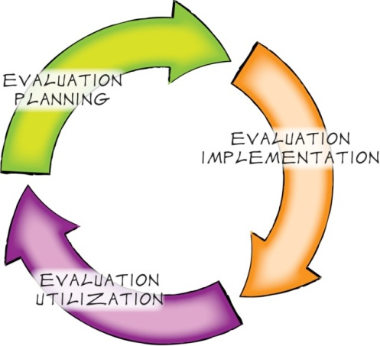
Importance of Program Models:
Link Planning, Management and Evaluation

Slide 5
Importance of Program Models:
Link Planning, Management and Evaluation

Slide 6


Developing high-quality program models
Systems Evaluation Protocol:
SEP
Need a step-by-step guide:
A “protocol”
The Netway Cyberinfrastructure
Need practical tools:
Preferably web-based

Slide 7
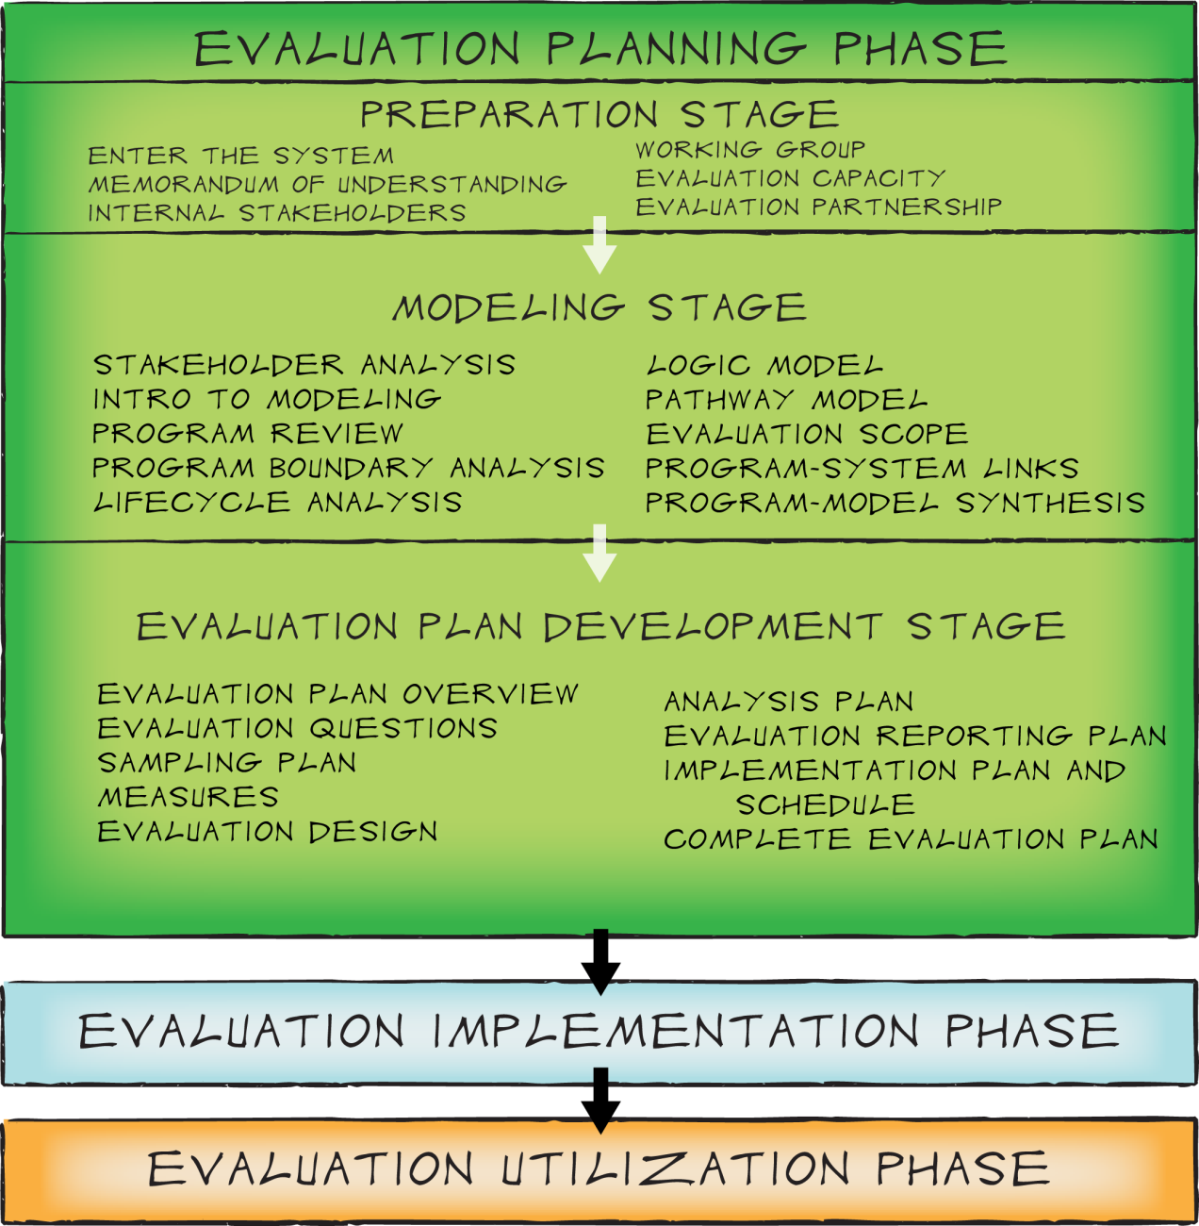
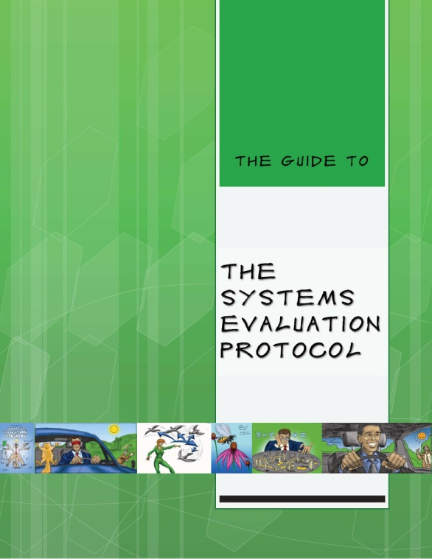
The Systems Evaluation Protocol (SEP)
https://core.human.cornell.edu/

Slide 8
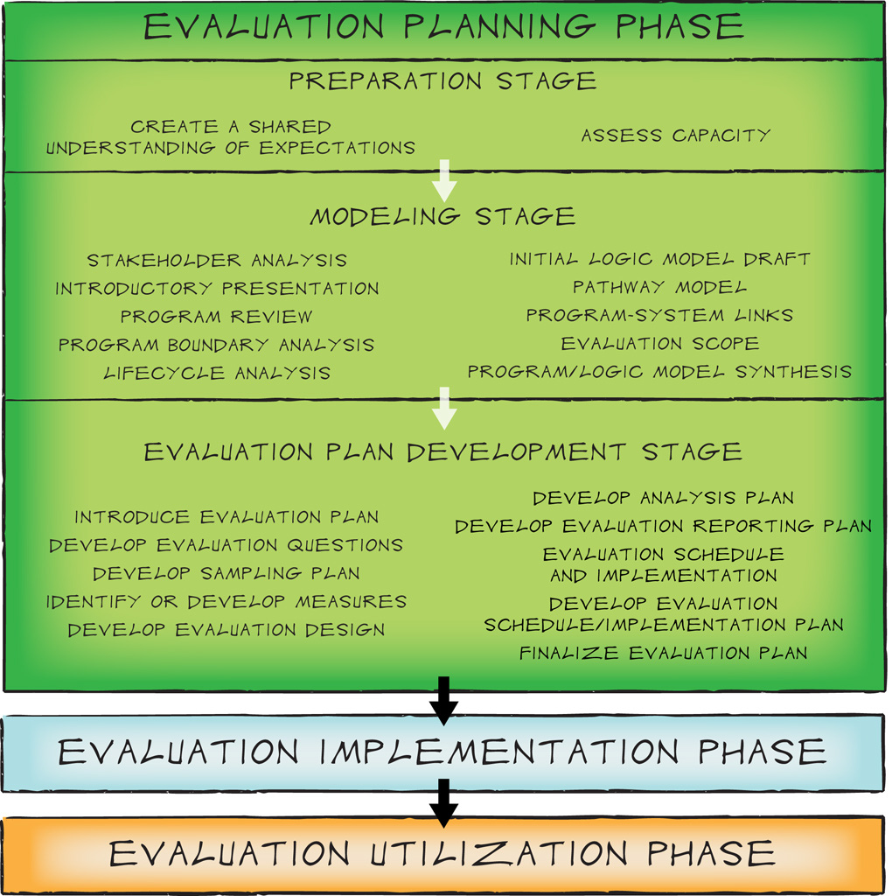
Developing the Program Model
Notes:
Protocol lays out a stepwise process despite the inherently iterative nature of the task.
Point out the “system-ness”
Note: we do not take partners through a series of so-called “systems tools” (social network analysis, etc.) but we do build the systems perspective into all the work on programs (see jen’s quote)

Slide 9
Developing the Program Model
1. Stakeholder Analysis: Determine all of the potential people and/or organizations that may have a stake in the program.
2. Program Review: Gain a firm understanding of the components and characteristics of the program including how it operates and whom it serves.
3. Program Boundary Analysis: Determine the conceptual limits of the program; what is “in” and what is “out” when defining the program.
4. Lifecycle Analysis: Determine the maturity of the program and how its level of evolution influences evaluation capacity and method choices.
5. Logic Model: Generate an initial logic model including the assumptions, context, inputs, activities, outputs, short-, medium-, and long-term outcomes.
6. Pathway Model: Use the logic model as a basis for articulating clear and direct linkages between program activities and outcomes.
7. Evaluation Scope: Determine the specific components of the pathway model that will be the focus in the upcoming evaluation cycle.
8. Program-System Links: Introduce tools and strategies for finding similar programs and shared outcomes, develop research support by drawing on literature and on resources in the systems within which the program exists
9. Reflection and Synthesis: Finalize the logic and pathway models including reviewing the program logic model, assessing the model from the perspectives of key stakeholders, reviewing the Program Boundary Analysis, reviewing the Program and Evaluation Lifecycle Analyses, and revising the models as needed. This step also involves integrating relevant research literature as it relates to the causal pathways that have been articulated in the Pathway Model.

Slide 10
Developing the Program Model: Outputs
Map of Stakeholders
Program Description
Lifecycle Charts
Program Logic Model
Program Pathway Model
Supporting and Background Literature

Slide 11
Stakeholder Analysis
Other Youth Programs
NYS 4-H
SUNY Morrisville Cobleskill
Cornell University
Local School Districts
Taxpayers
CCE Staff
Youth
Funders
JCADCA
Dairy Program
Volunteers
Parents
NYS Jr. Holstein Association
Local Ag Businesses
FFA Teachers
Breed Associations
CCE Board of Directors
4-H Members
National Dairy Industry
Jefferson County Fair Board
Surrounding County Youth
Jefferson County Dairy Producers
State Fair
Jefferson County Legislatures
Media
4-H Dairy Program: Stakeholder Map
Notes:
We invite EP participants to cast a “wide net” when thinking about stakeholders – those who care about (or would care if they knew about) the program.

Slide 12

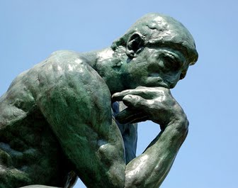
Logic Models
LOGIC
MODEL
Notes:
LM’s incorporate thinking, reasoning, “logic” (of course), to produce a representation of something you want to show or describe. As a model, you have to decide what elements to include and how much detail you need, while not overburdening the model too much. It has to be readable, comprehensible, and should succeed in conveying the essential ideas about what the program is, what it entails, and how it works.

Slide 13
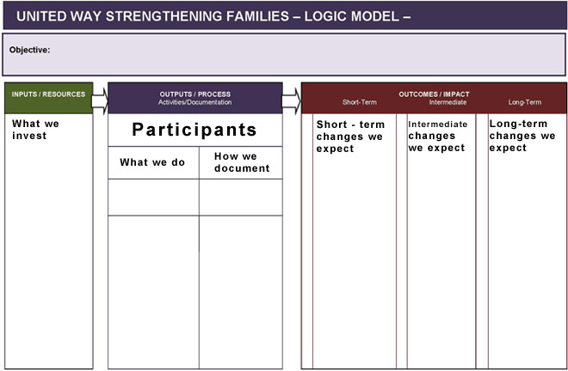
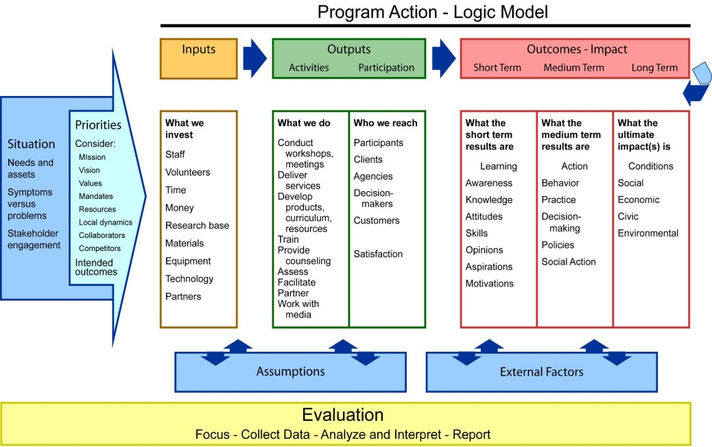
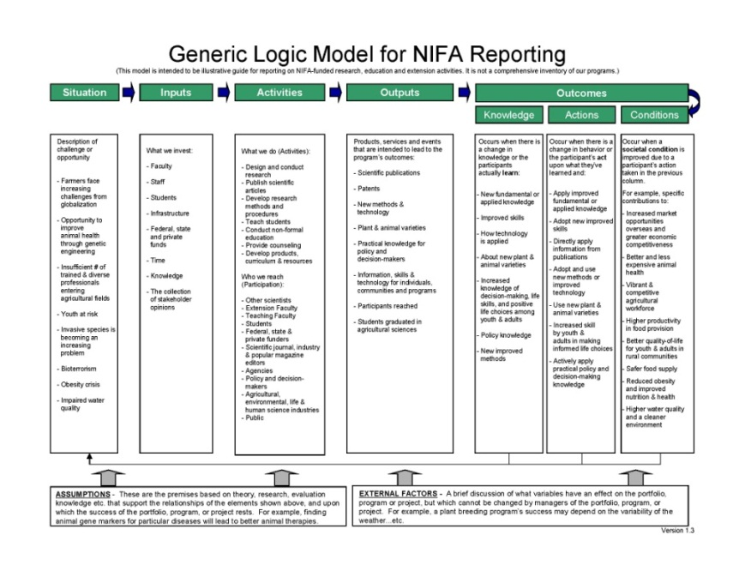
Lots of LM Formats out there…
http://www.csrees.usda.gov/business/reporting/part/gen_logic_model.pdf
Notes:
There are lots of formats and templates out there. Note what features are common and what features are different in various models.

Slide 14
LM Formats: United Way
Notes:
There are lots of formats and templates out there. Note what features are common and what features are different in various models.

Slide 15

LM Formats: University of Wisconsin Extension
Notes:
Here we have a full depiction of program development. We see that everything starts with a clear articulation of the originating situation from which priorities are set. This sets into motion the programmatic response – as displayed in the logic model of what is expected to occur…the connections and relationships between inputs-outputs- and outcomes.
Often not included in the graphical LM display but important to articulate are
Assumptions
External factors, for example, do financial institutions exist; are they accessible
(barriers and facilitators)
Evaluation runs over the course of the program and is part of the program design.
Looks linear but is not…

Slide 16

LM Formats: USDA Nat’l Institute for Food and Ag
http://www.csrees.usda.gov/business/reporting/part/gen_logic_model.pdf

Slide 17
How do we build a Logic Model?
The parts of a Logic Model
  Assumptions
  Context
  Inputs
  Outputs
  Short-term Outcomes
  Mid-term Outcomes
  Long-term Outcomes
Need a guide to putting these together

Slide 18
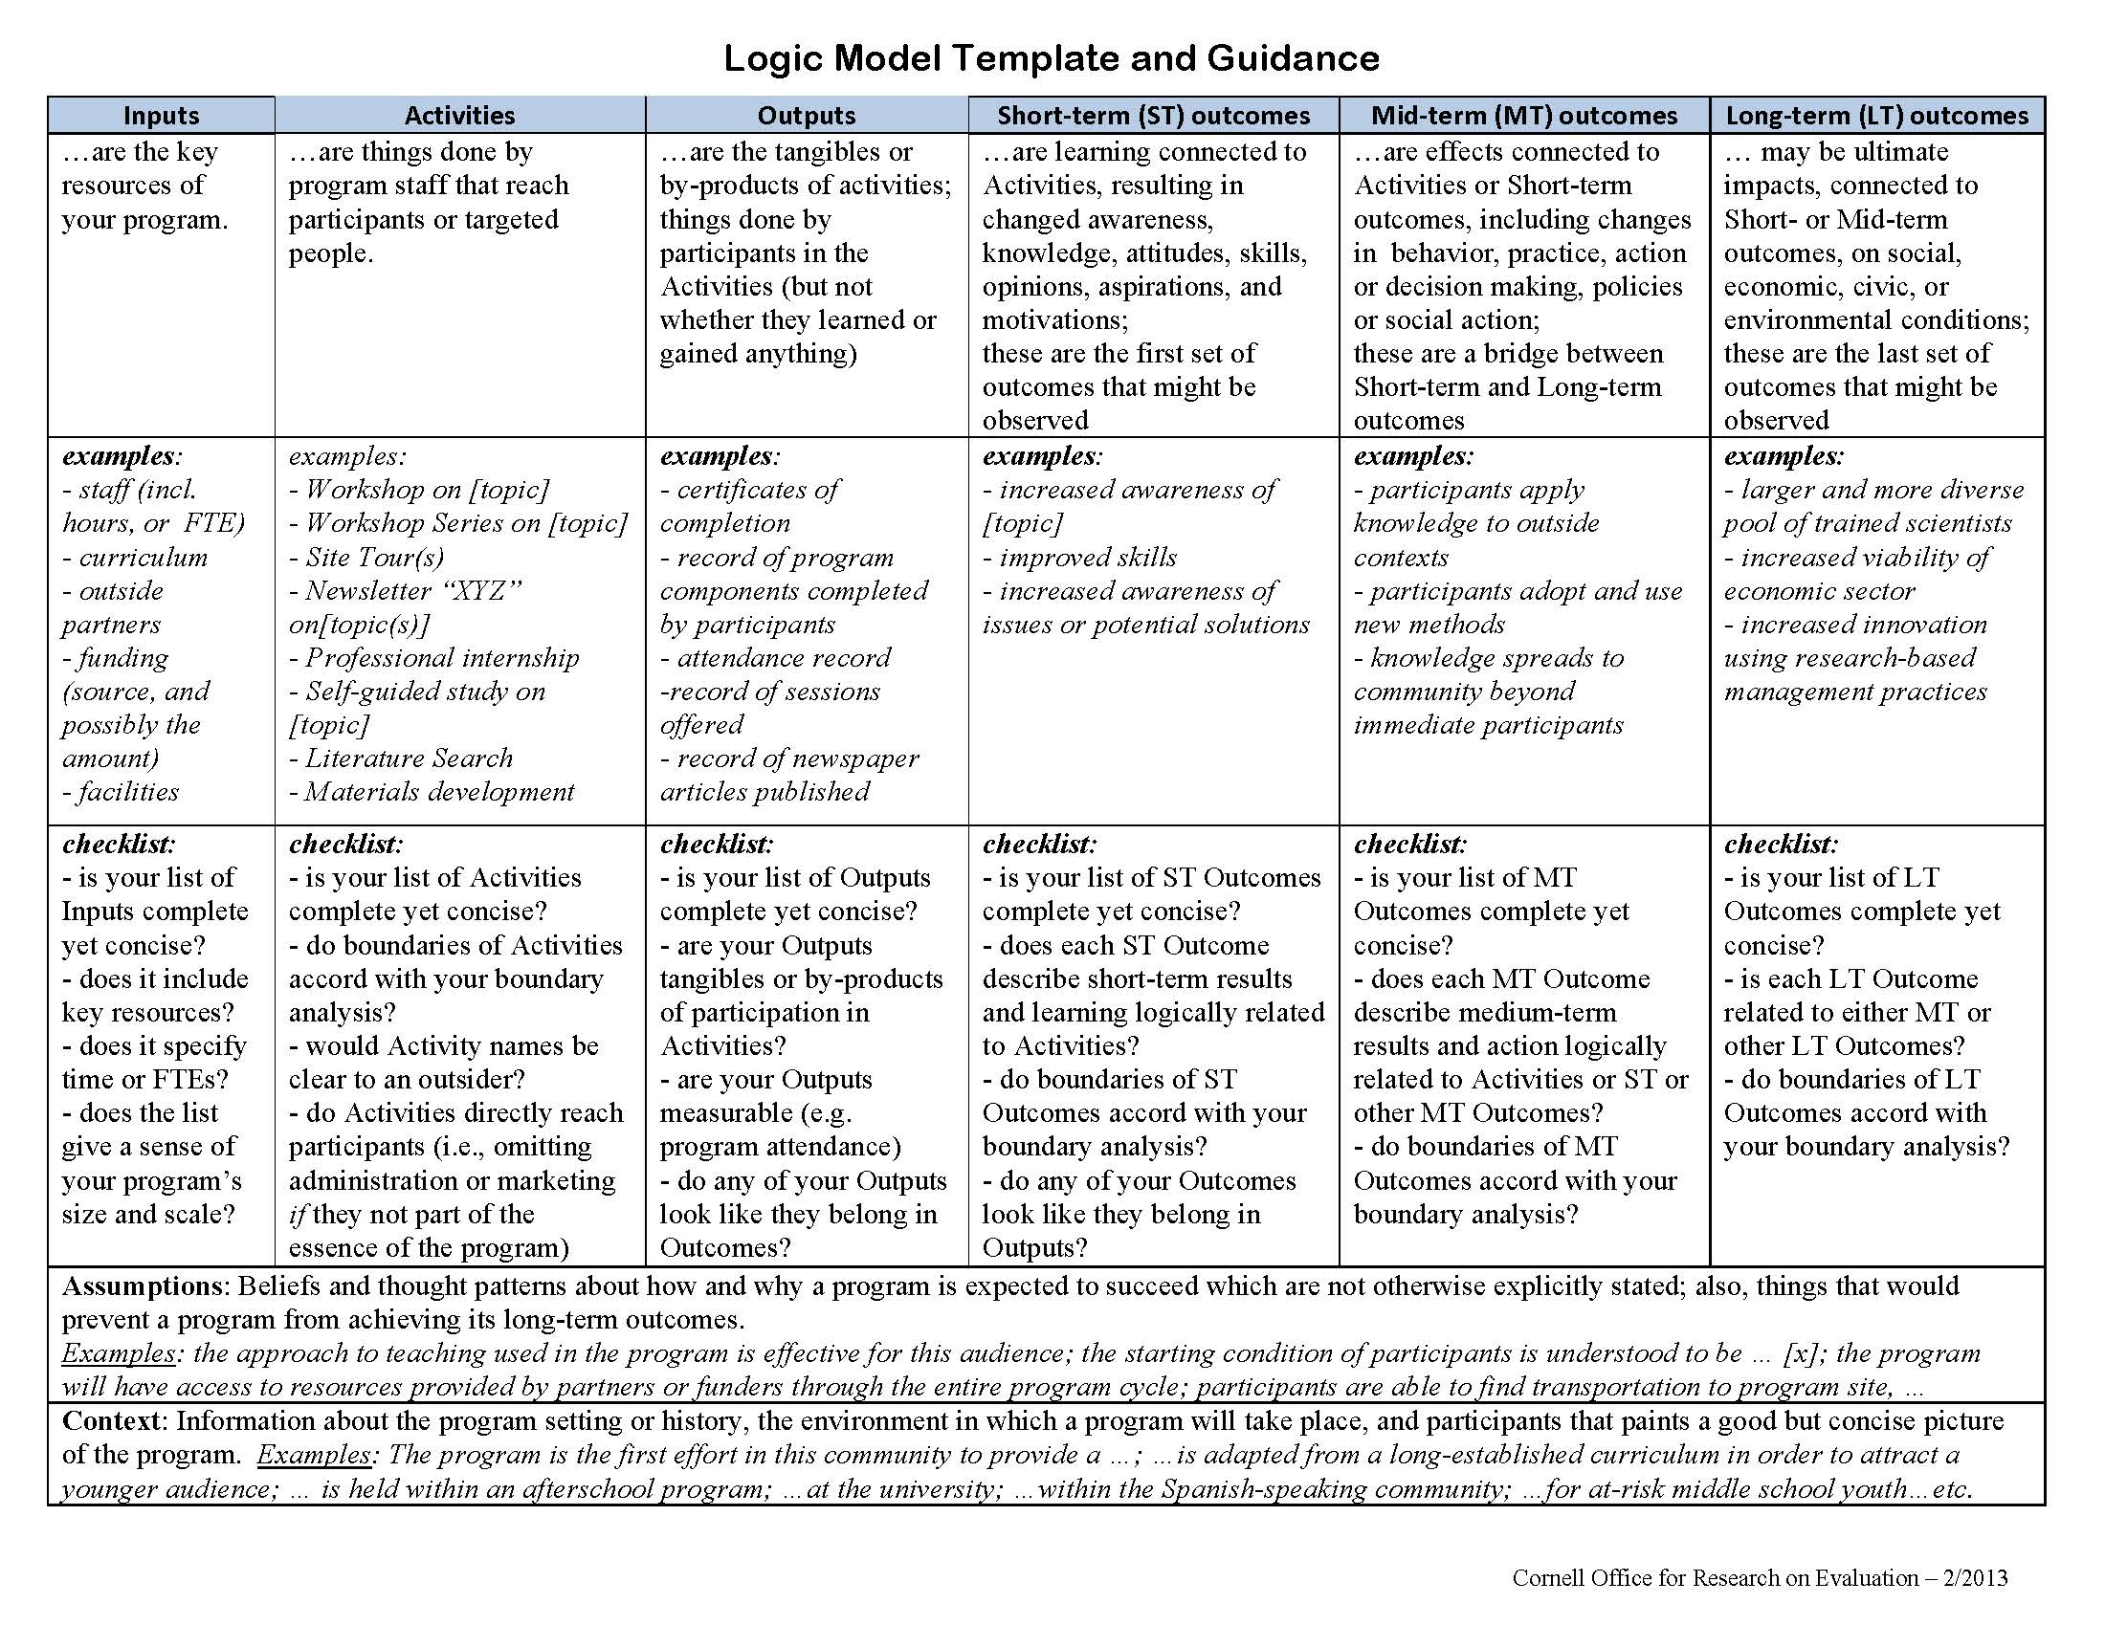
CORE’s “Logic Model Template”

Slide 19
CORE’s “Logic Model Template”

Slide 20
CDC Examples

Slide 21
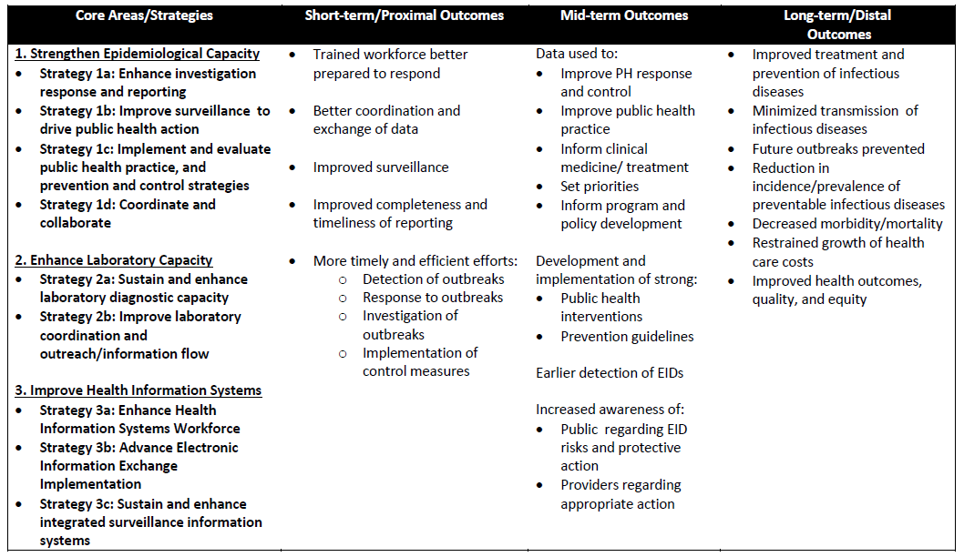
Epidemiology and Laboratory Capacity (ELC) for Infectious Diseases Logic Model

Slide 22
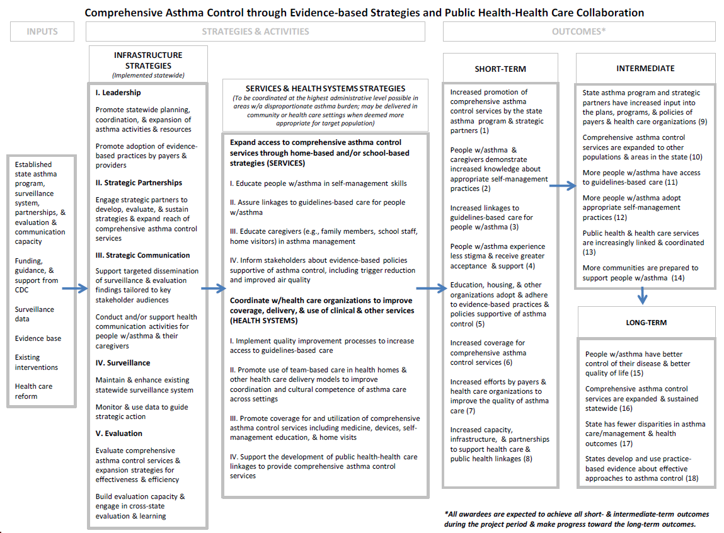
Comprehensive Asthma Control Logic Model

Slide 23
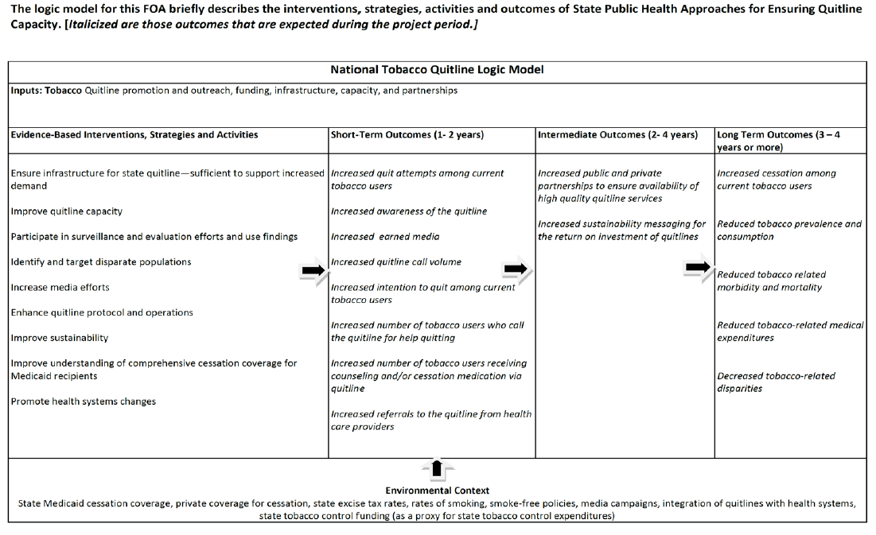
National Tobacco Quitline Logic Model

Slide 24
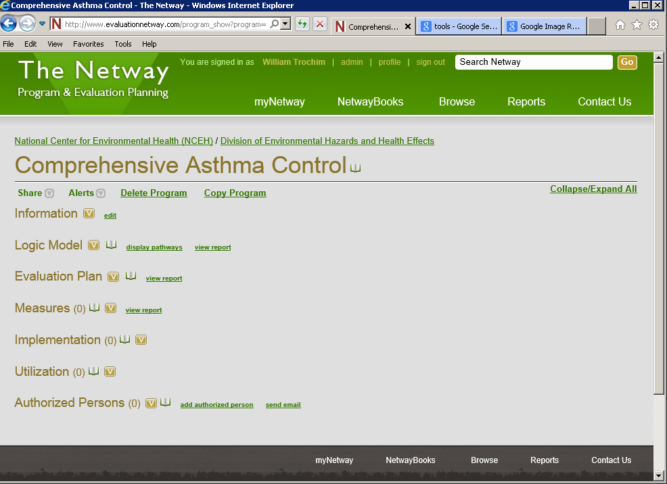
The Netway
Web-based software developed by CORE
Facilitates program modeling and evaluation planning
Increases shared knowledge and identifies connections among programs
Notes:
Netway is a key tool for developing Logic Model, Pathway Model, Evaluation Plans
And sharing ideas, learning from others, identifying shared outcomes (because you can see and search everything in the Netway, even though you can only create and edit your own, plus there are built-in mechanisms for keeping track of outcomes that are common to multiple programs.)

Slide 25
Exercise 1: Critiquing a Logic Model
Entering a Logic Model in the Netway
Review the example CDC Logic Model
Look at the checklist in row 3 of the Guideline
Pair up
Discuss how well each of the checklist elements are met in the logic model
Group discussion

Slide 26
From Logic Models to Pathway Models
The problem with columnar logic models
  Don’t provide enough detail
  Don’t show cause-and-effect
  Don’t show pathways - throughlines
  Don’t highlight “key” nodes
  Don’t effectively tell the story
How do we construct a pathway model?

Slide 27
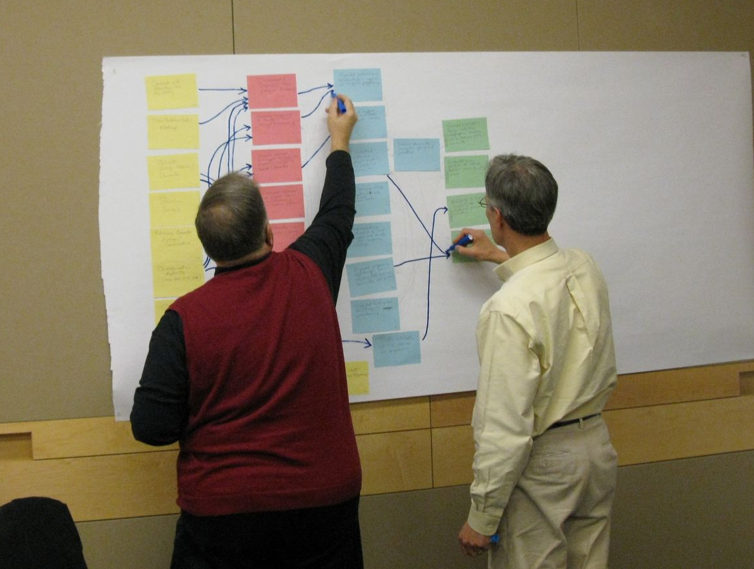
“Mining the Model”

Slide 28
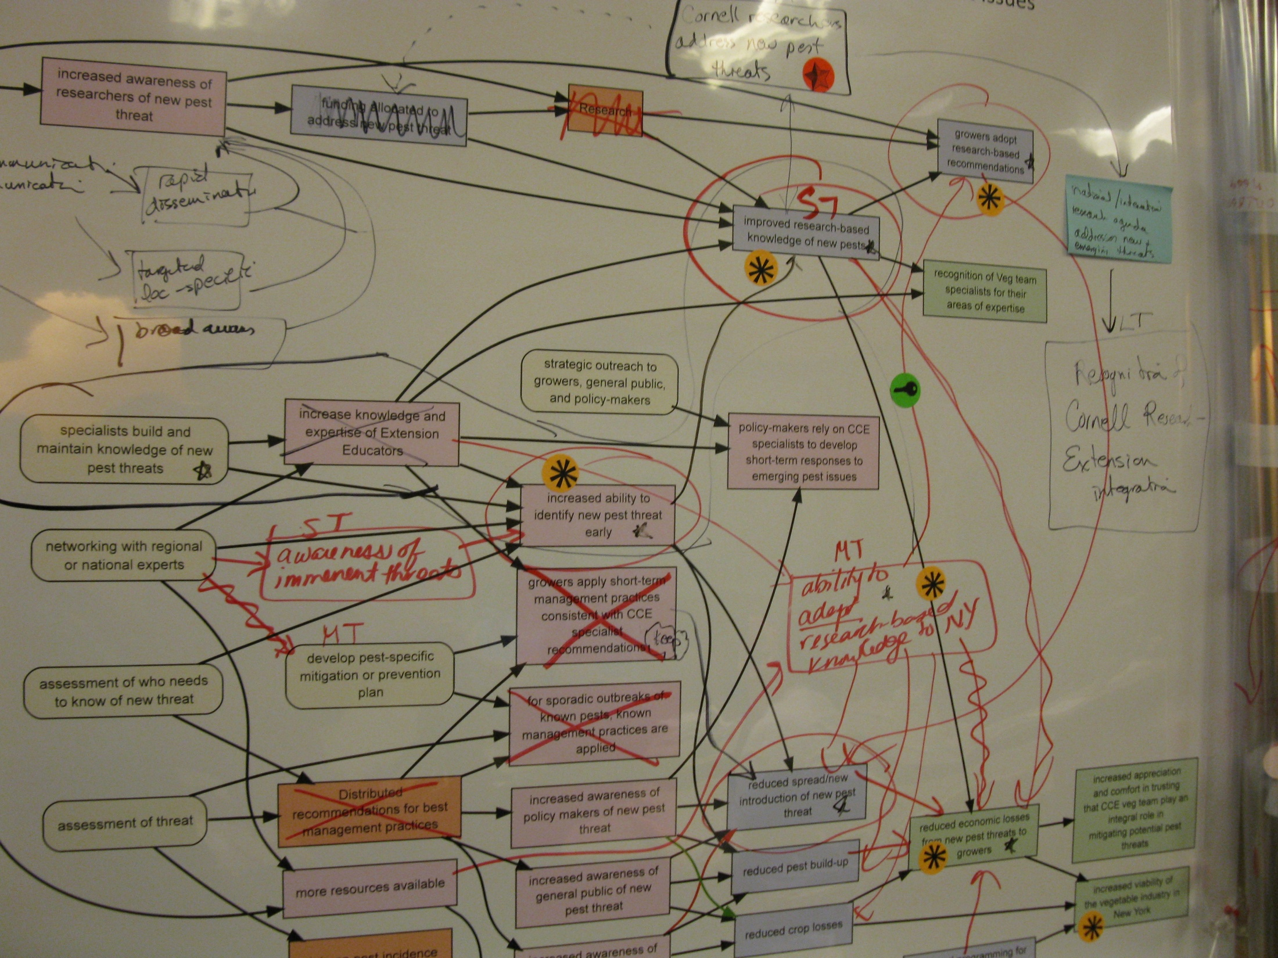
“Mining the Model”
Notes:
The thinking and development stage can be complicated. But in fact it is in the shared building of the model, and then iterations of commentary and feedback, that many of the gains are achieved – this is where people manage to get on the same page in terms of their understanding of what their program is about.

Slide 29
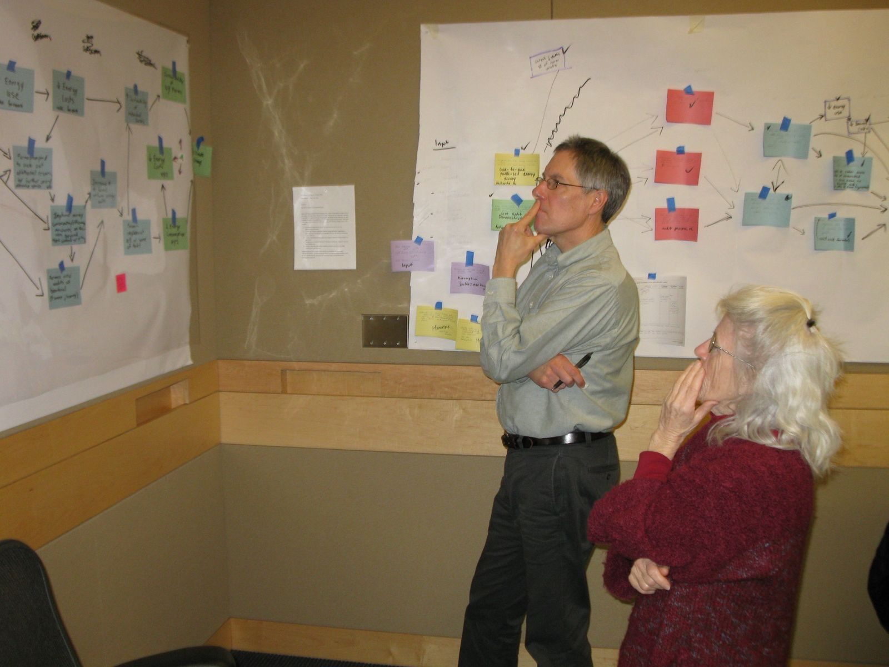
“Mining the Model”

Slide 30
Exercise 2: Drawing Pathways
Use a CDC Logic Model
Pair up
Identify one key pathway – the one you think is most critical
  Activity → ST Outcome → MT outcome → LT outcome
Draw the pathway on the model
If time, identify one or two additional pathways
Enter pathways into Netway

Slide 31


Key Features of a Pathway Model
Key Nodes
Throughlines

Slide 32
Exercise 3: Identifying Key Pathway Features
Look at the logic model(s) and pathway model(s)
Identify the two or three likely key nodes
Identify the two or three likely key pathways
What do these suggest about the program?

Slide 33
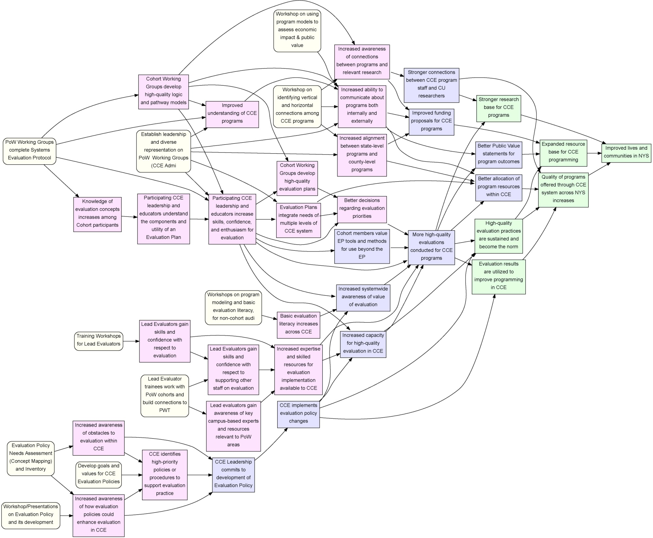
A More Detailed Example
Activities
Short Term Outcomes
Mid Term Outcomes
Long-Term Outcomes
“Building Evaluation Capacity in CCE System and Programs, 2012-15”

Slide 34
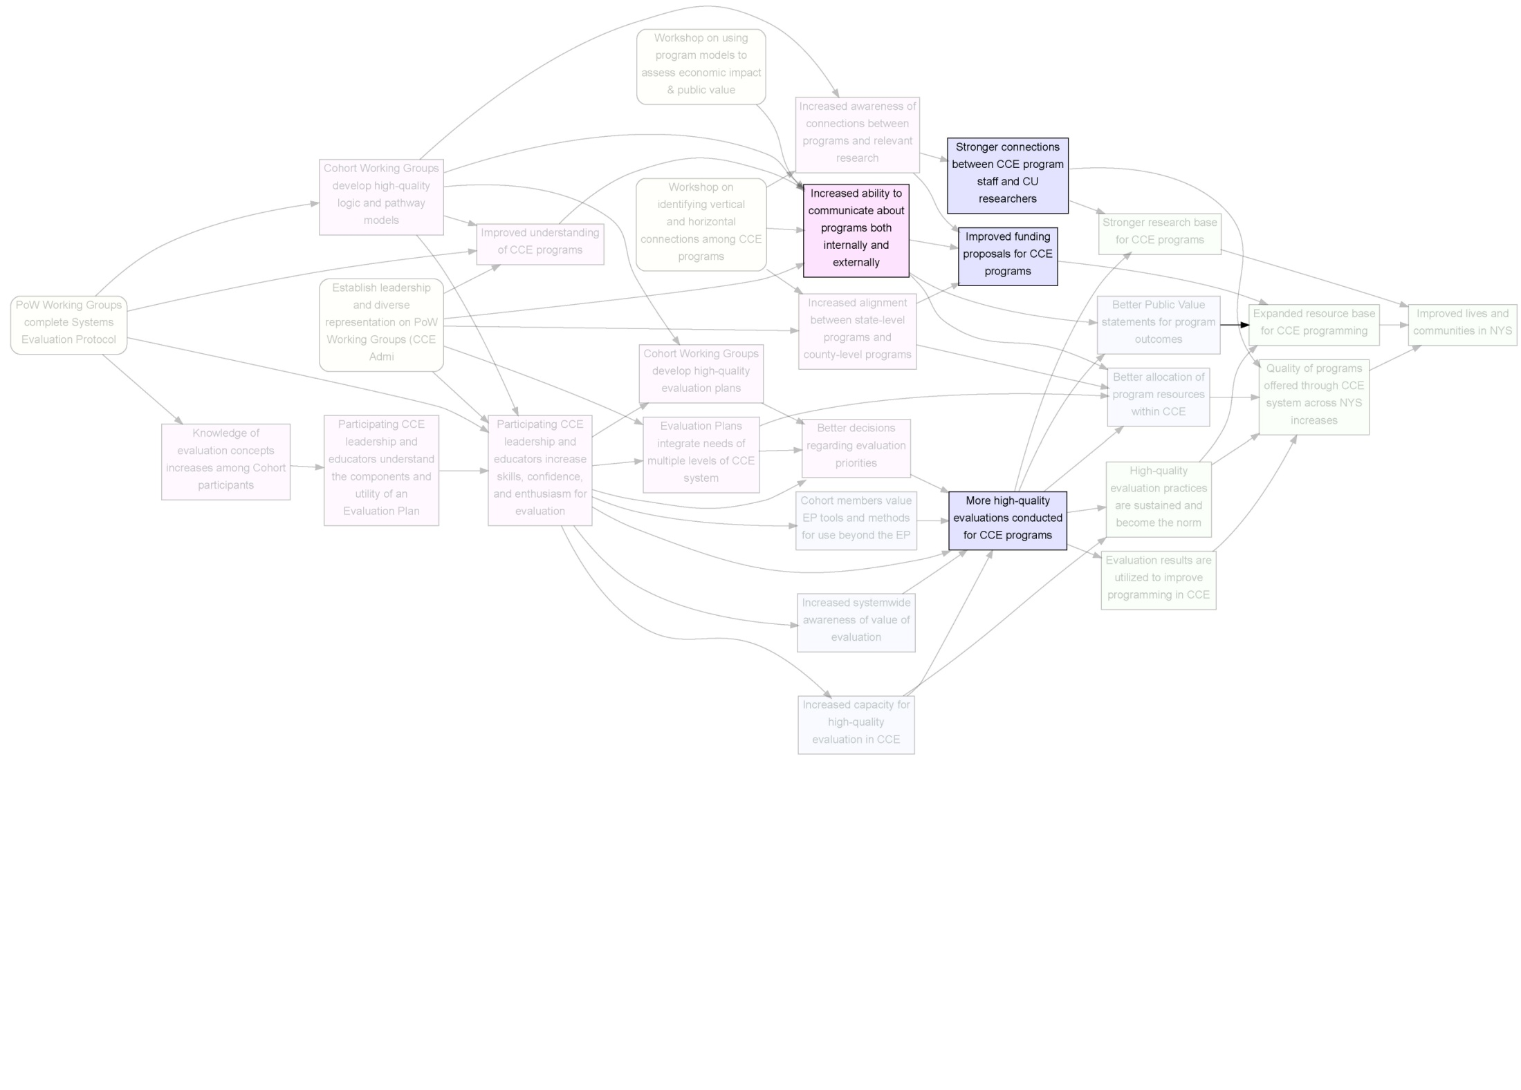
Four Key Objectives of the Project

Slide 35
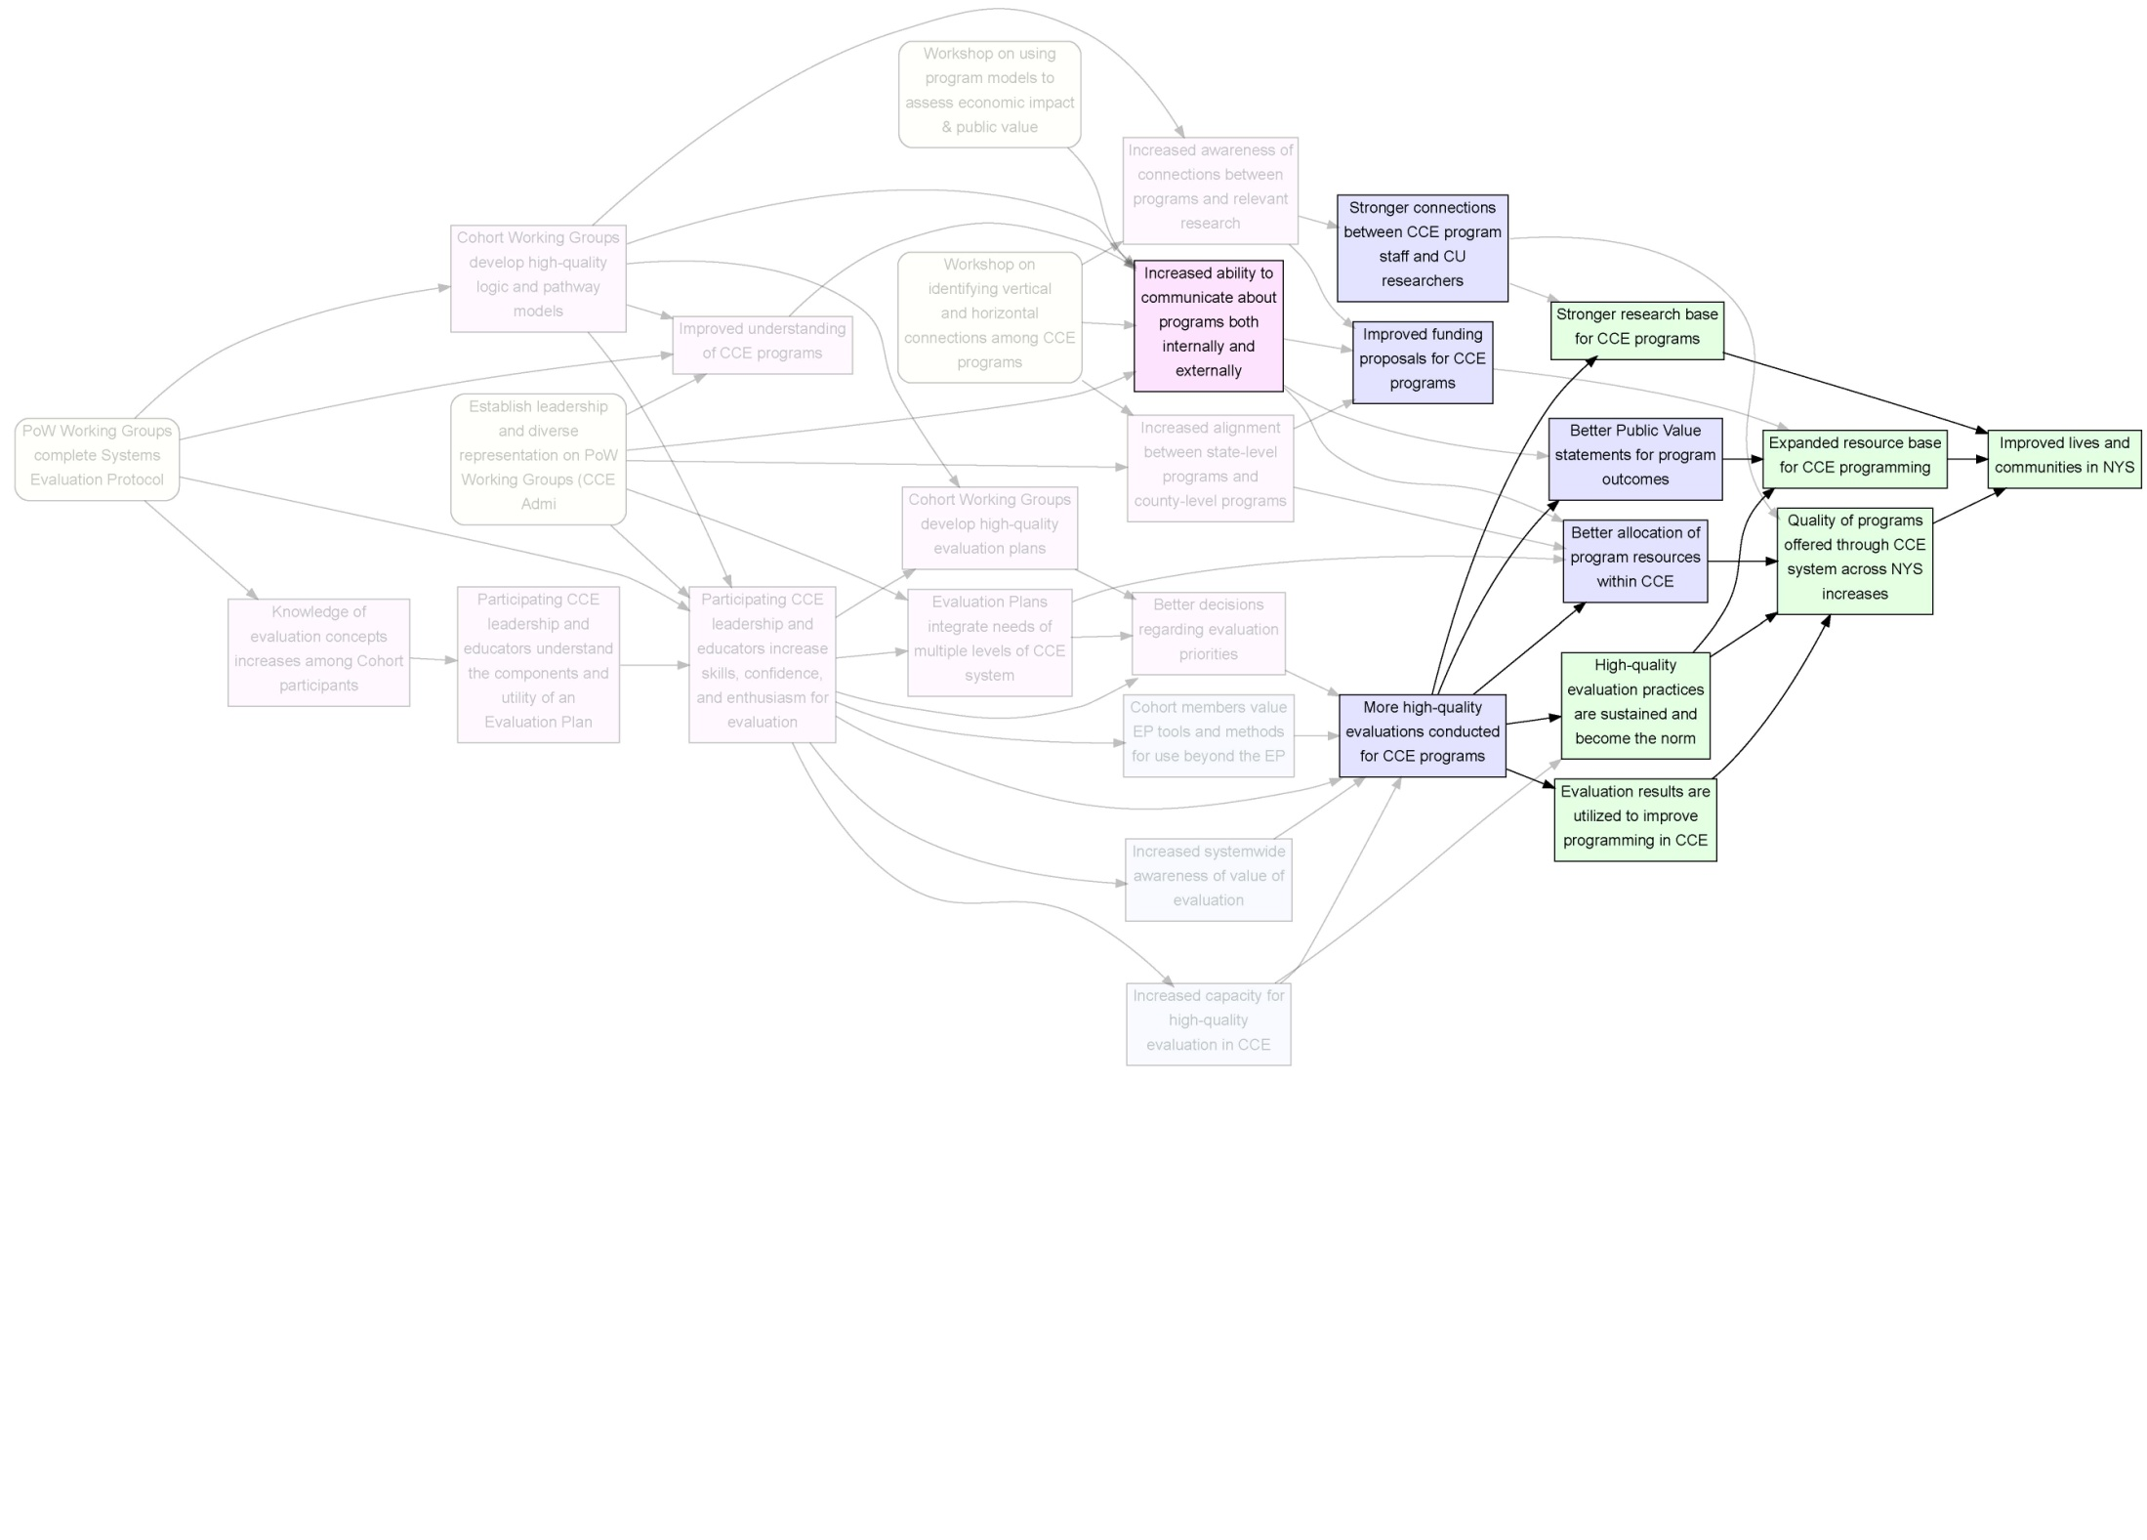
Four Key Objectives of the Project
… and why they are so critical

Slide 36
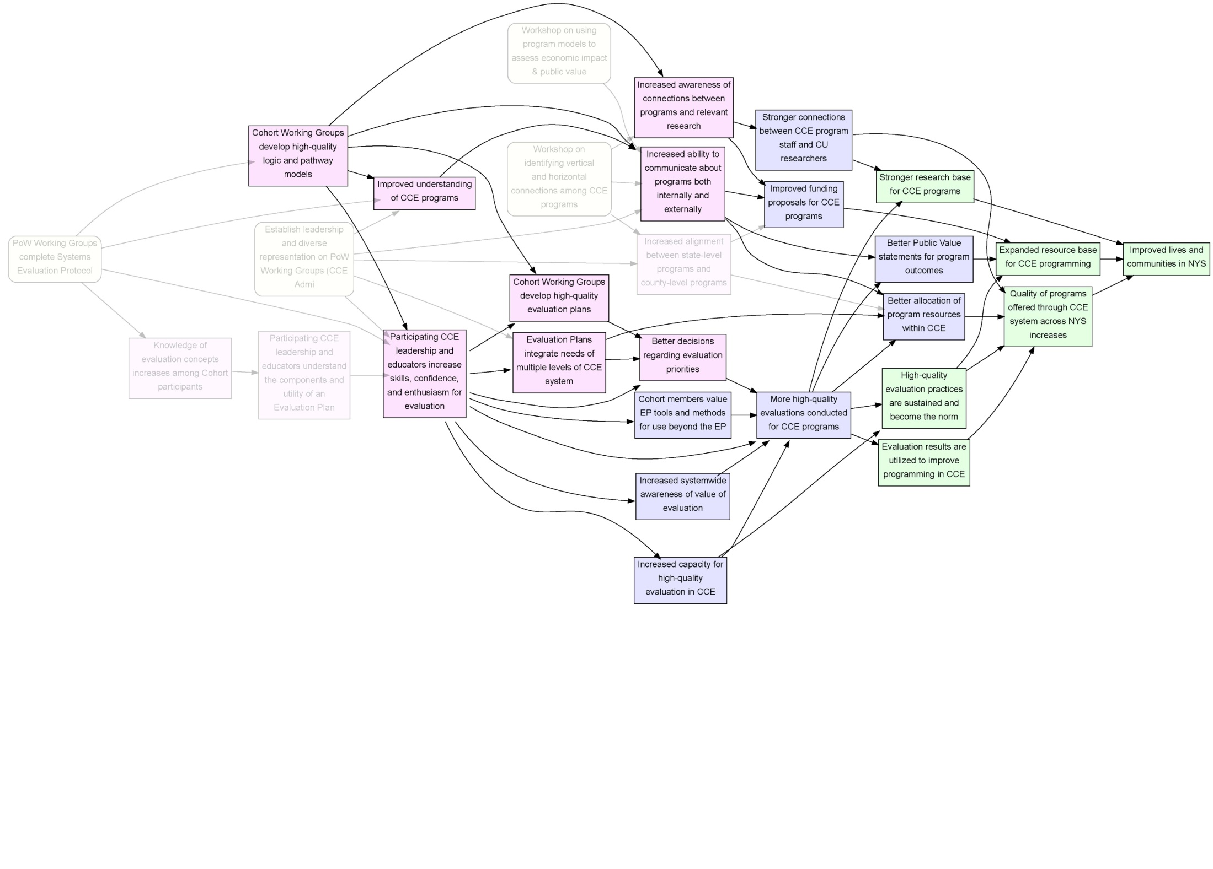
Key “milestones” in the project

Slide 37
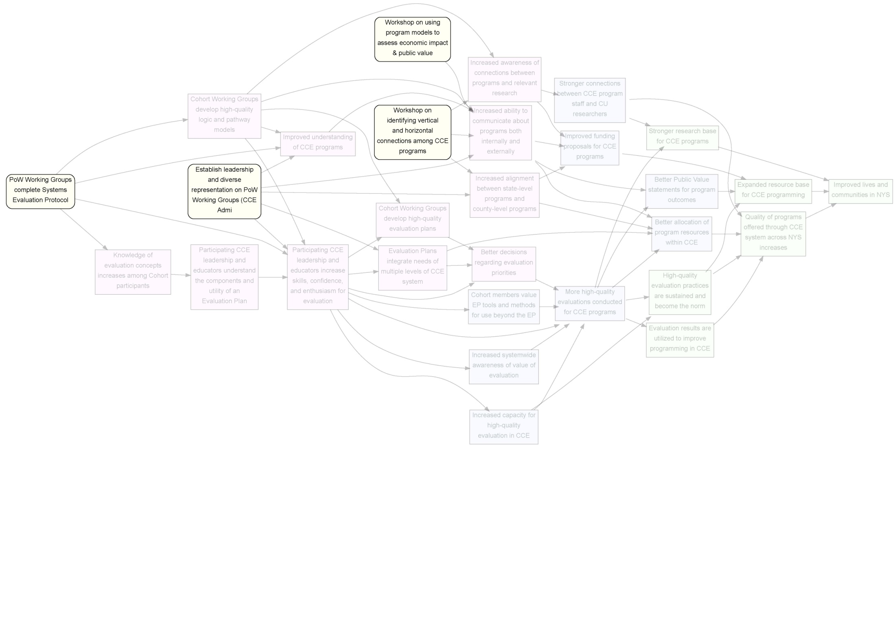
How do we do it?

Slide 38
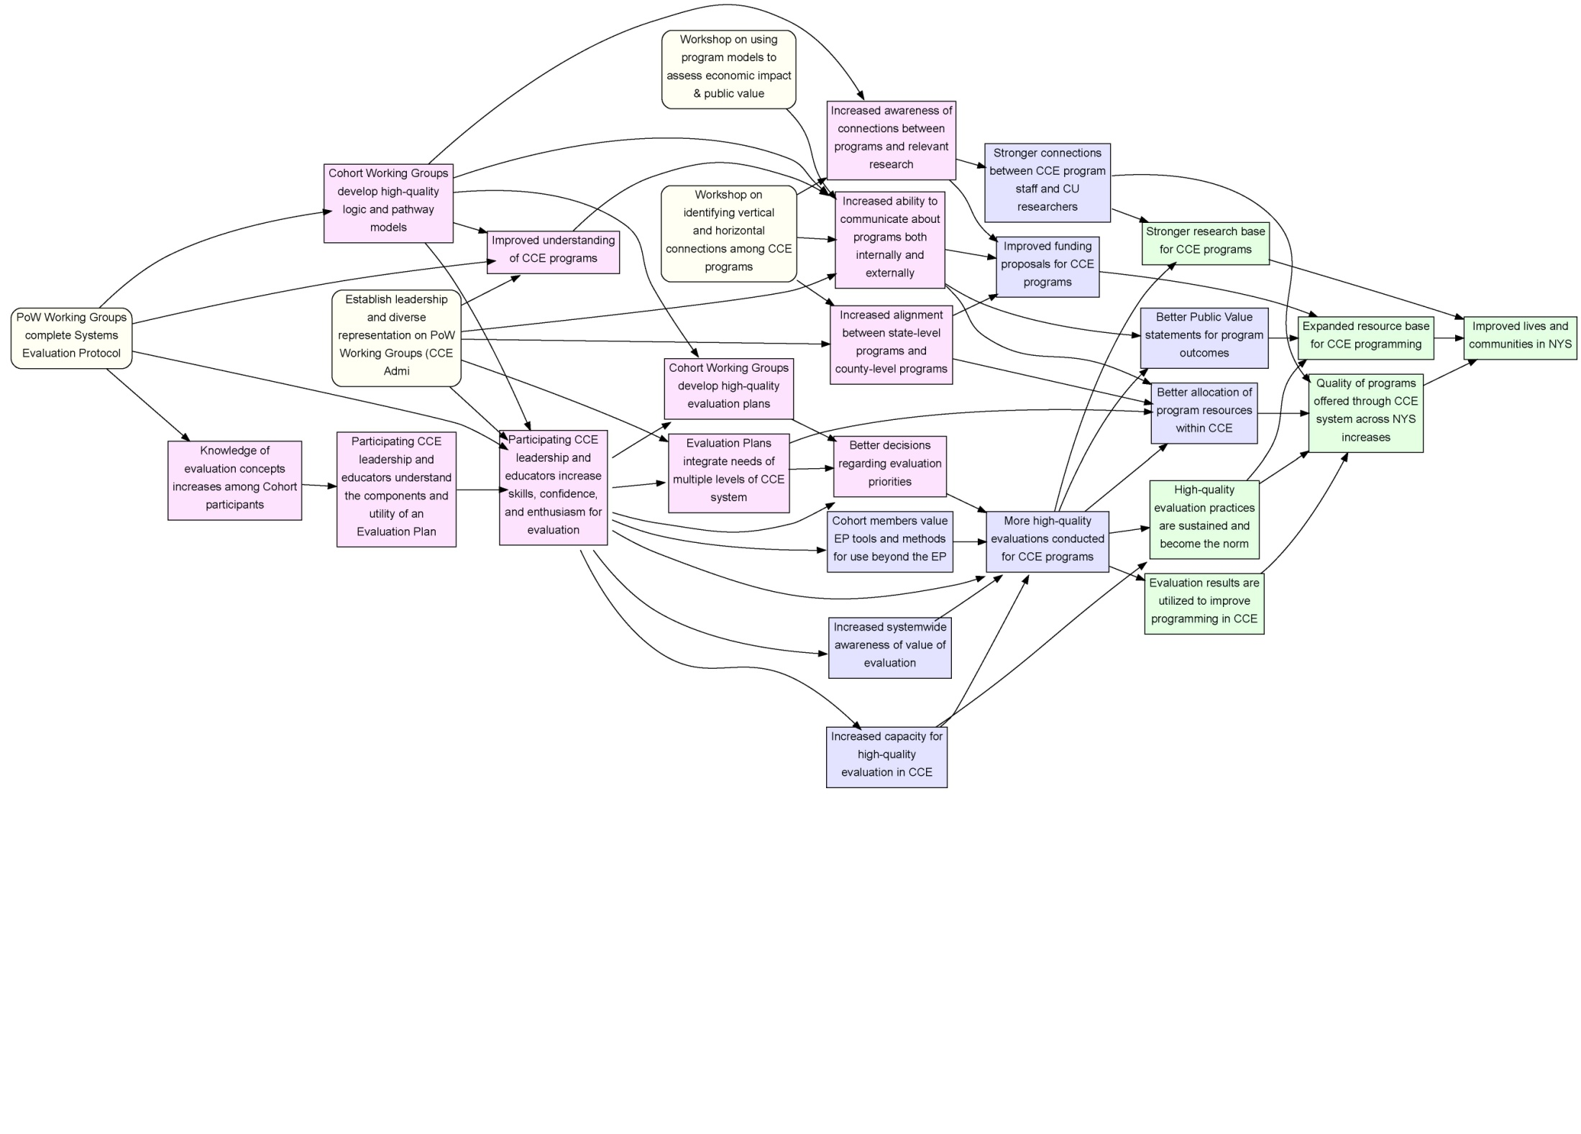
The big picture for Evaluation Partnerships based around the CCE Plans of Work
Activities
Short Term Outcomes
Mid Term Outcomes
Long-Term Outcomes

Slide 39
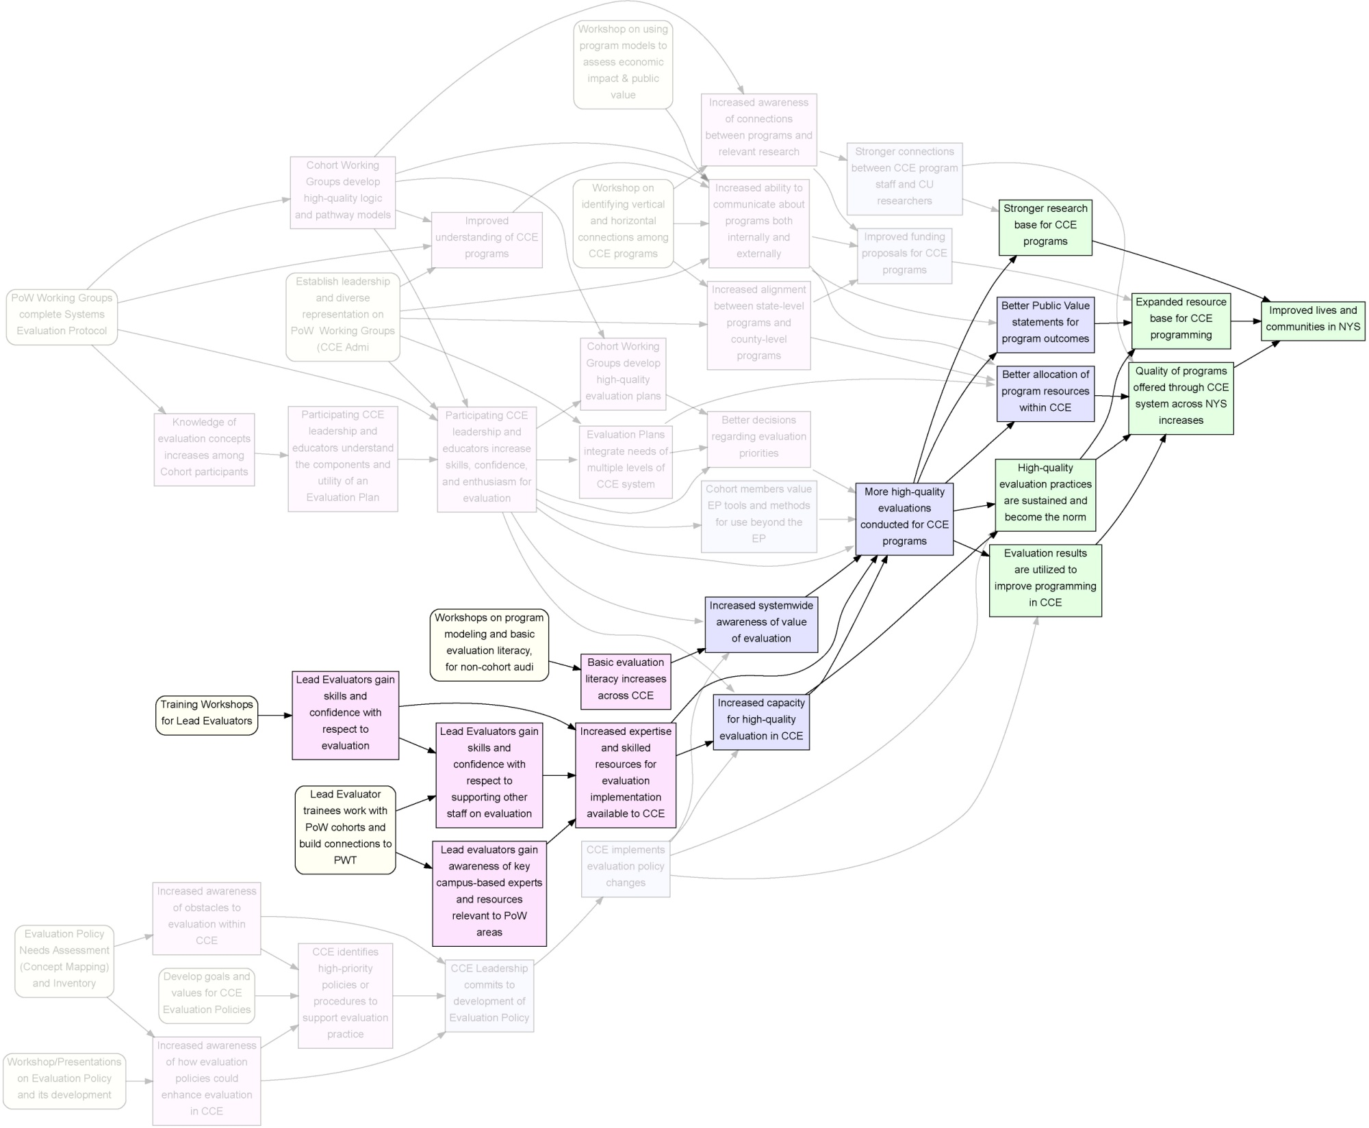
Contribution of “Lead Evaluators” and enhanced Evaluation Literacy across CCE
Activities
Short Term Outcomes
Mid Term Outcomes
Long-Term Outcomes

Slide 40
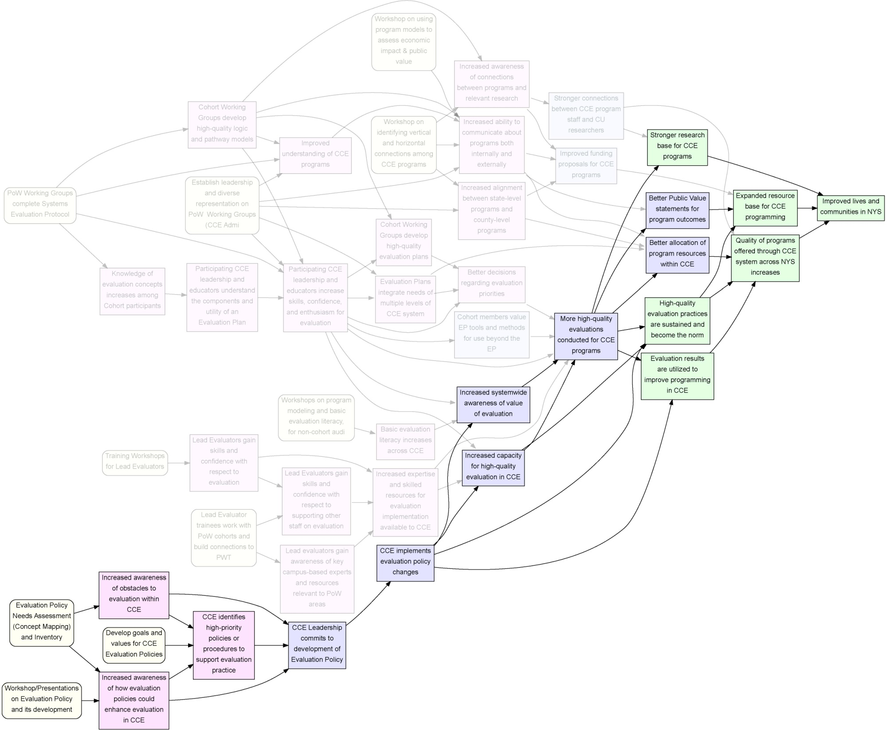
Activities
Short Term Outcomes
Mid Term Outcomes
Long-Term Outcomes
Essential additional component: Comprehensive Evaluation Policy

Slide 41
Activities
Short Term Outcomes
Mid Term Outcomes
Long-Term Outcomes
“Building Evaluation Capacity in CCE System and Programs, 2012-15”

Slide 42
What else do we do with Pathway Models?
Improve quality of Pathway Model
  Incomplete pathways: some activities and outcomes omitted
  Leaps: jumps from activities to MT or LT outcomes
  Orphans:
    outcomes that have no activities
    activities that don’t lead anywhere
Link to Evidence base:
  Literature for nodes (examples or measures)
  Literature for paths

Slide 43
Wrapping up Modeling Stage
What I didn’t cover:
  Program boundary analysis
  Lifecycle analysis
  Evaluation scope
Notes:
Protocol lays out a stepwise process despite the inherently iterative nature of the task.
Point out the “system-ness”
Note: we do not take partners through a series of so-called “systems tools” (social network analysis, etc.) but we do build the systems perspective into all the work on programs (see jen’s quote)

Slide 44
From Program Model to Evaluation
Notes:
Protocol lays out a stepwise process despite the inherently iterative nature of the task.
Point out the “system-ness”
Note: we do not take partners through a series of so-called “systems tools” (social network analysis, etc.) but we do build the systems perspective into all the work on programs (see jen’s quote)
Now I’m going to turn this over to Kelsey, who is going to talk about existing definitions of evaluation quality.

Slide 45
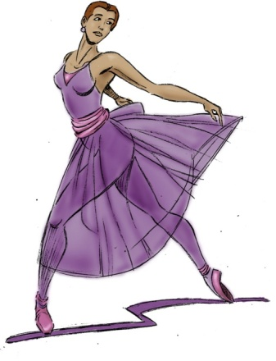



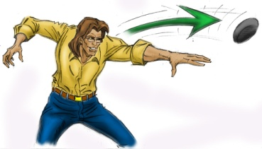
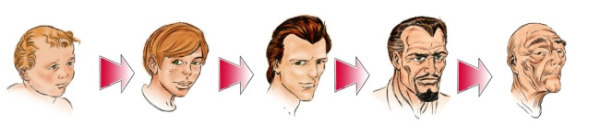

A “systems approach” to evaluation
Our systems approach draws on systems thinking, complexity theory, evolutionary theory, …
Static vs. Dynamic Processes
Whole is more than sum of parts
Symbiosis
Phylogeny
Ontogeny

Slide 46
Implications for evaluation
Programs are viewed (and modeled) as
  parts of larger systems
  dynamic and evolving
  related to other programs in the present
  connected to past and future programs
  being perceived differently by different stakeholders and systems
Evaluation plan development takes this into account and should help programs and systems evolve

Slide 47
What leads to a high-quality Evaluation Plan?
Consistency with a high-quality program model
Fitness of evaluation plan elements to the program and program context
Internal alignment of the evaluation plan elements
Holistic coherence

Slide 48
1. Consistency with a high-quality program model
A “high-quality model” …
  is grounded in knowledge of the program
  incorporates perspectives of multiple stakeholders
  shows causal pathways (program logic)
  reflects careful thought about program “boundaries”
  includes program assumptions and key elements of context
  is connected to program evidence base (relevant research)
“consistency with…” means
  evaluation questions can be located in terms of model elements
  evaluation “scope” makes sense

Slide 49
2. Fitness of evaluation questions/plan to the program and program context
Evaluation questions are “mined” from the model
Evaluation questions are appropriate for the program’s maturity and stability, existing state of knowledge, and program needs
Evaluation focus, methods, and tools meet needs of key stakeholders
Evaluation plan makes efficient and strategic use of program and evaluation resources

Slide 50
3. Internal alignment of the evaluation plan elements
Measures fits the constructs
Measure is the most strategic option among those that fit
Design is appropriate for lifecycle stage
Design can support claims implied in purpose statement
Sampling and Analysis plans can generate evidence needed

Slide 51
4. Holistic coherence
The most difficult element
Evaluation planning requires myriad decisions about multi-faceted tradeoffs
Making these decisions well requires a holistic comprehension of the program and the environment and systems that embed it
The decisions may be invisible in the written plan so some of the resulting quality might be ascertainable, some of it will not be
Notes:
(somewhere in here I want to use the line “you can lead a horse to water but you can’t make him think” …☺)
This 4th point is about that synergistic extra element, where the whole is greater than the sum of the parts. It’s that extra bit.

Slide 52

Positive Feedback
There was a huge improvement in the ability to design programs.
It's been very good for clarifying what we want to accomplish for funding purposes.
[This process] required a different kind of thinking. Not the “seat of the pants” kind of way of working at things that we have done … but really logically thinking through all the steps.
It became much easier to more clearly and more quickly articulate impacts.
… now we can really identify and comment on the end products of our evaluations in the form of hard data that we can bring to grant meetings and include in proposals.
It’s a lot of work, and you have to be prepared to set aside time in your busy life. But I think it was really valuable.
It makes you think more critically about what you're doing…”.
Notes:
Nevertheless participant feedback, facilitator observation, and other measured outcomes pointed to many benefits relevant to other parts of people’s Extension work. There’s strong potential! So the focus became: how to embed evaluation more constructively and seamlessly into the system – get it into the “air and water” – while also building individual capacity and access to resources
(Sources of quotes: Selected from post-EP Interviews conducted by SRI (n=136) and comments by Veg Team participants during Ag-in-Service presentation in November 2011.)

Slide 53
